Slide 1
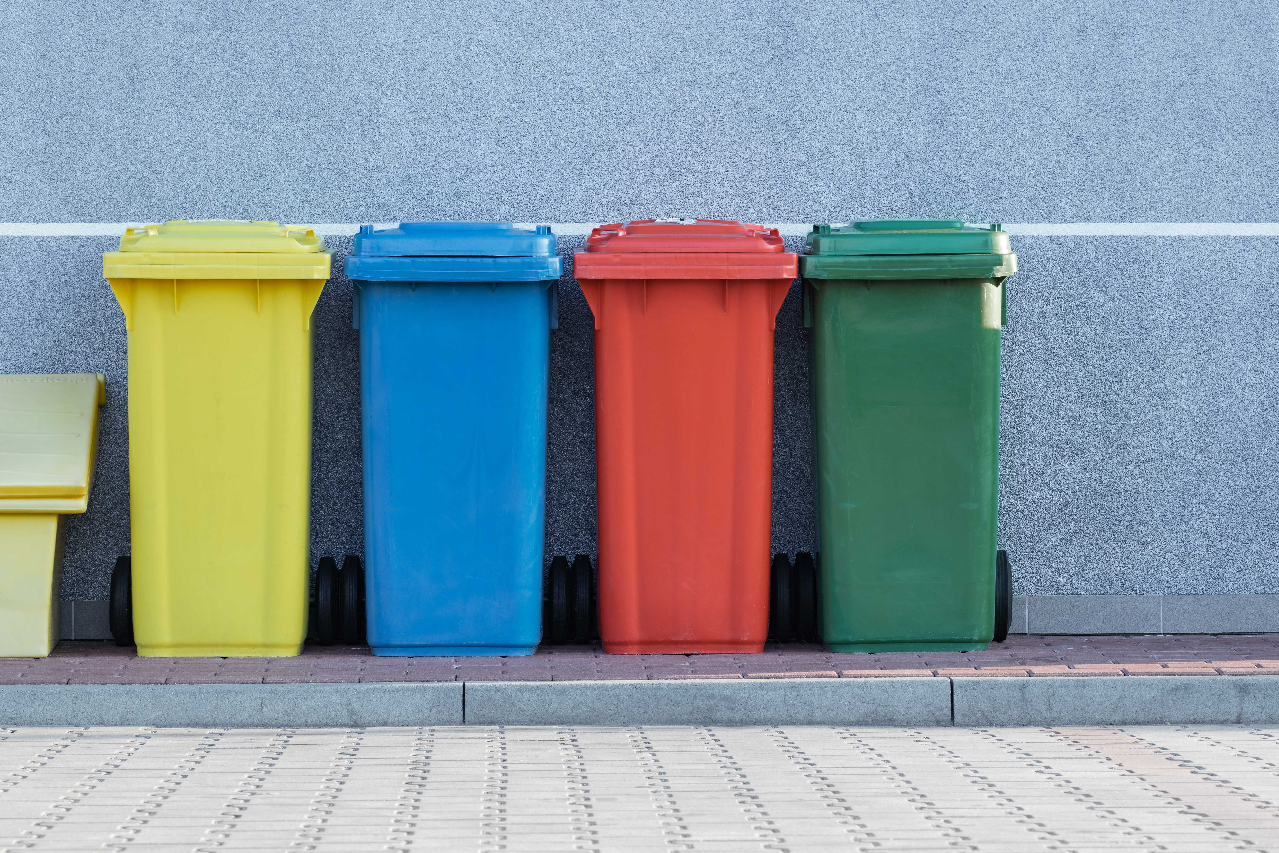
WasteNet
Mahdi, saghar, salina, warren, Nasreen, HANS, KEVIN, AMIR (Mentor), ZUBIA (team lead)

Slide 2
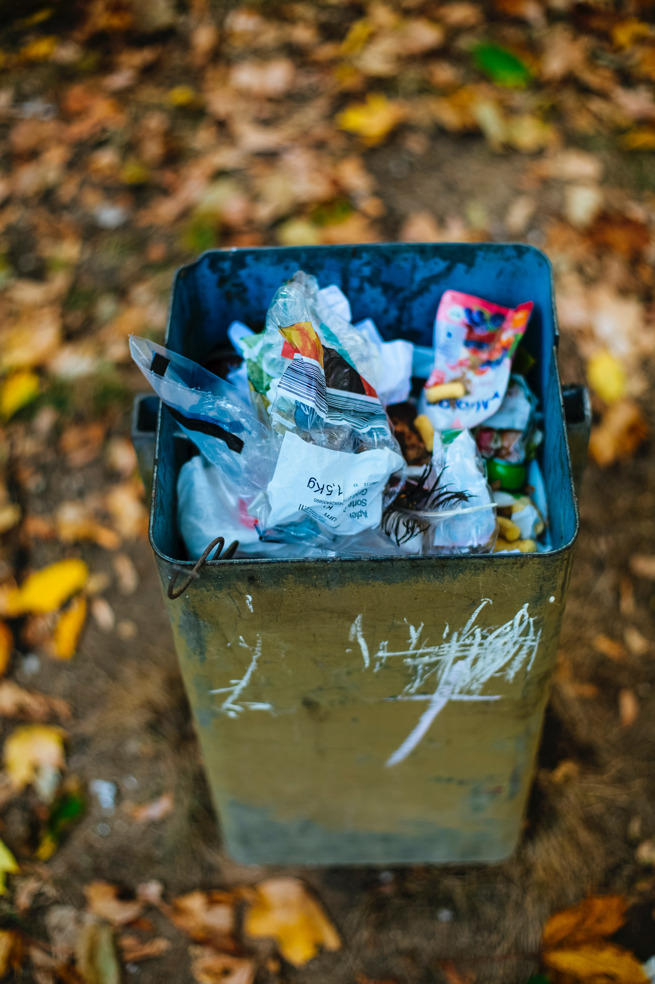
Project goal
Problem statement
To predict the category for different waste items using image classification
Relevance
Can be used to correctly identify and sort recyclable items with less contamination

Slide 3
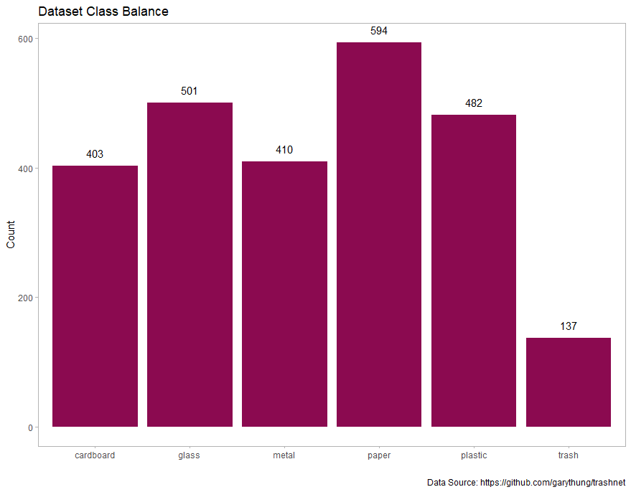
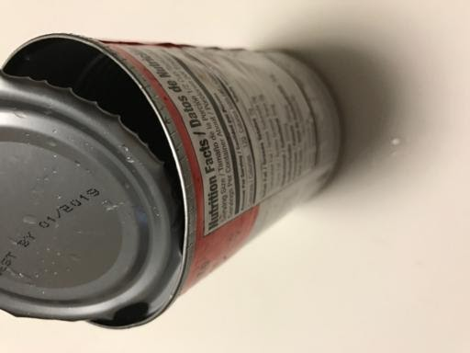
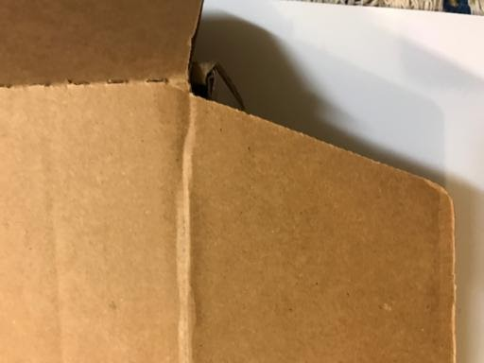
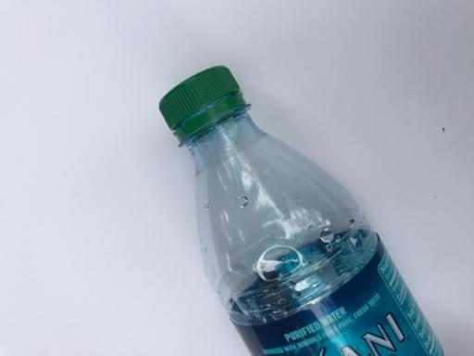
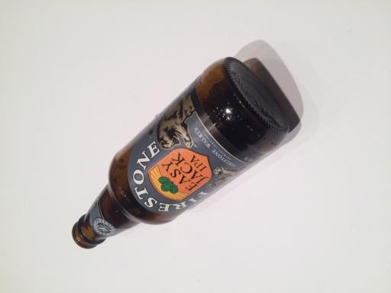
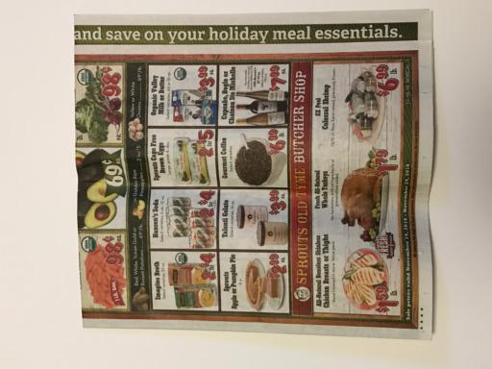
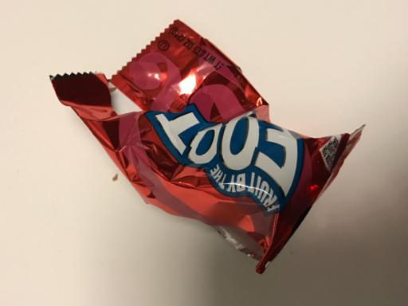
data
https://github.com/garythung/trashnet
Total of 2527 images of objects over 6 classes
70% Training (n=1768)
15% Validation (n=379)
15% Test (n=380)

Slide 4
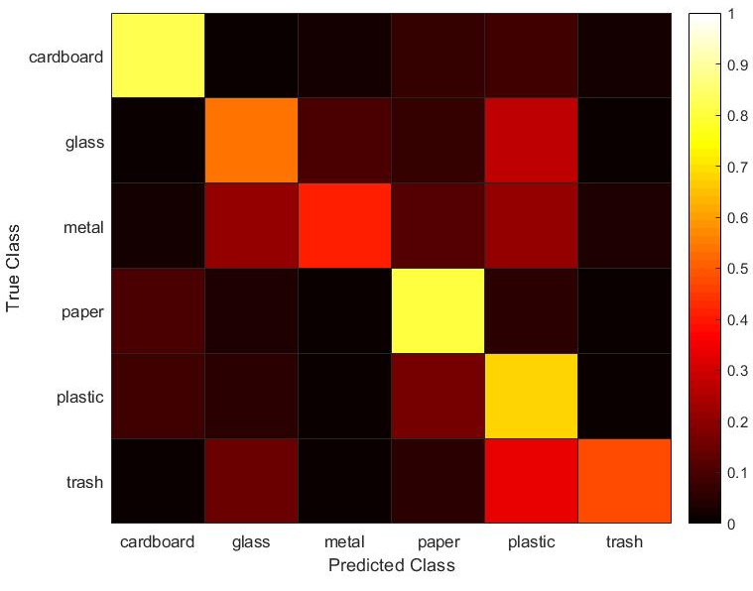
MODELS (SVM)
SVM
Confusion Matrix on Testing Data
Training accuracy: 90.7%
Testing accuracy: 64.6%
HOG Feature Extraction
Inputs
Cubic SVM Classifier
Output Labels

Slide 5
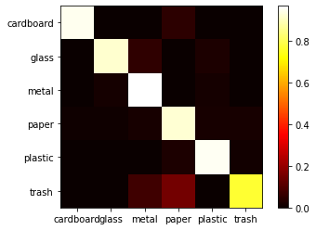
MODELS (ResNet)
Pre-Trained ResNet
Confusion Matrix on Testing Data
Adjusted weight for trash class (1:4 ratio)
Training accuracy: 98%
Testing accuracy: 93%
Update Model (True\False)
Pretrained
Resnet18
Inputs
Linear Classifier
Output Labels

Slide 6
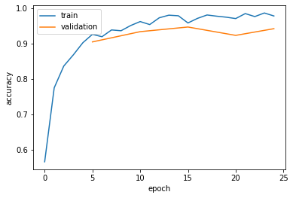
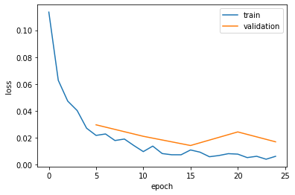
MODELS (ResNet)
Pre-Trained ResNet
Accuracy
Adjusted weight for trash class (1:4 ratio)
Training accuracy: 98%
Testing accuracy: 93%
Update Model (True\False)
Loss
Pretrained
Resnet18
Inputs
Linear Classifier
Output Labels

Slide 7
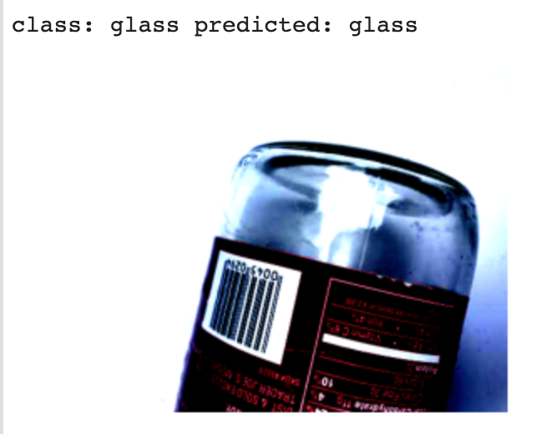
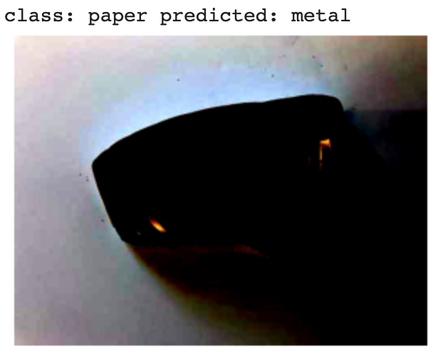
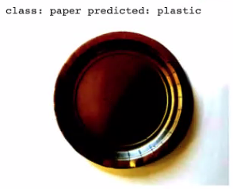
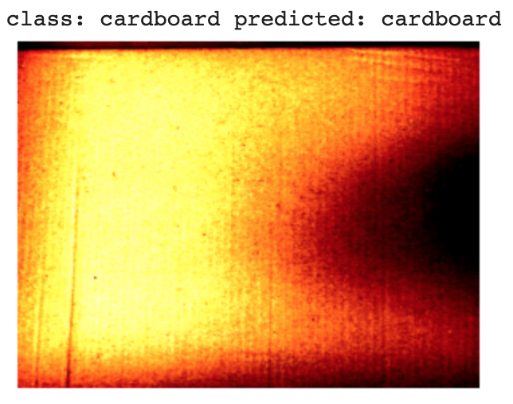
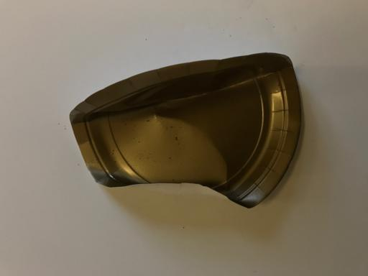
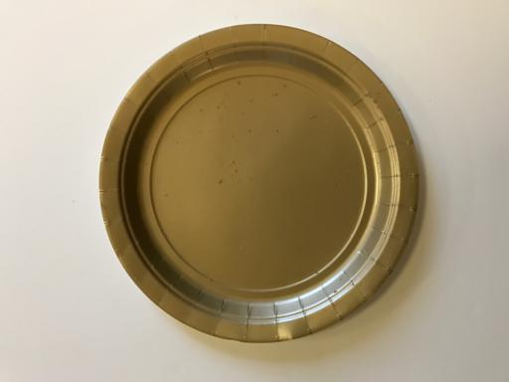
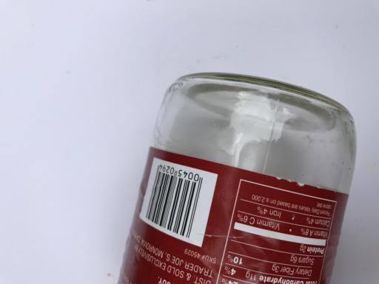

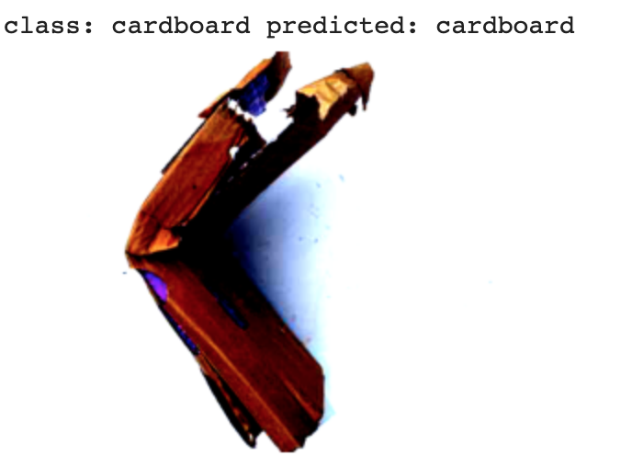
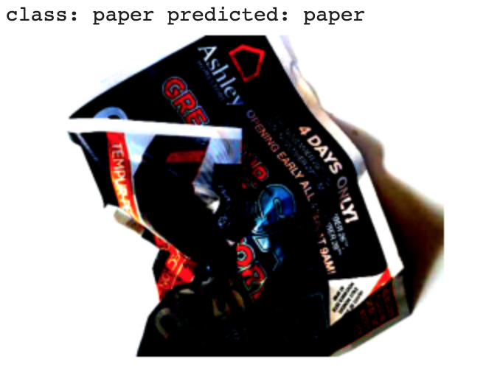
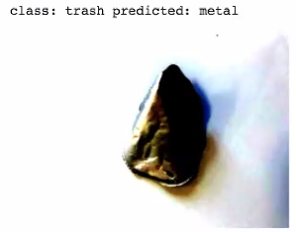
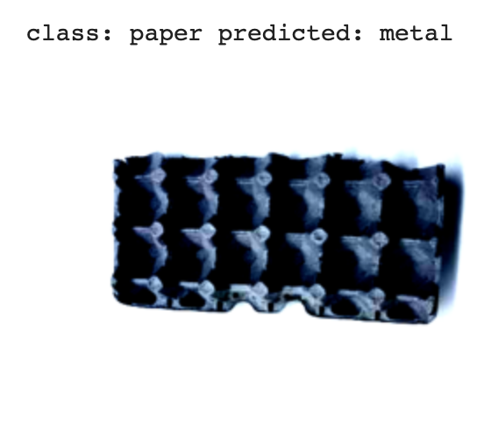
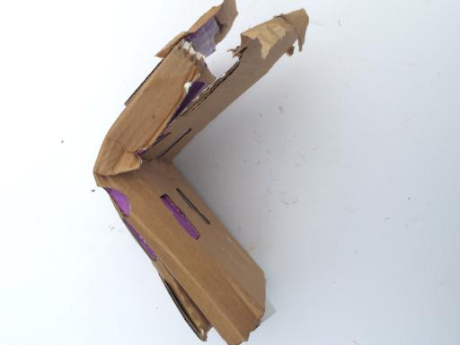
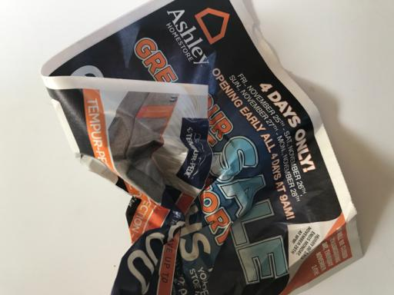
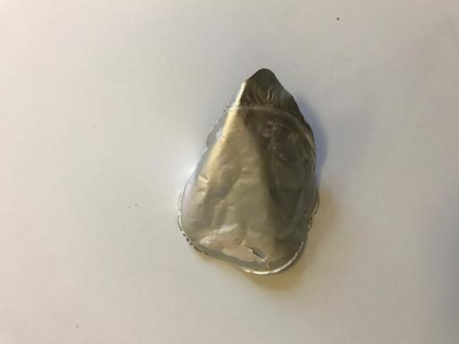
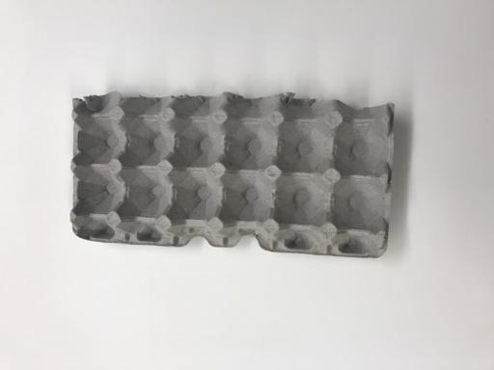
Result example
Success cases ✅
Error cases ❌
Notes:
"Is this paper???"

Slide 8
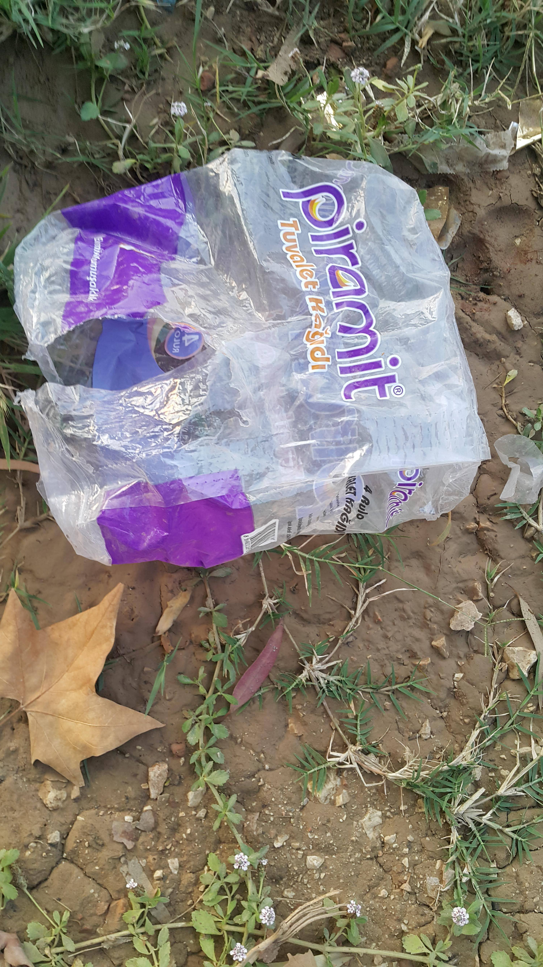
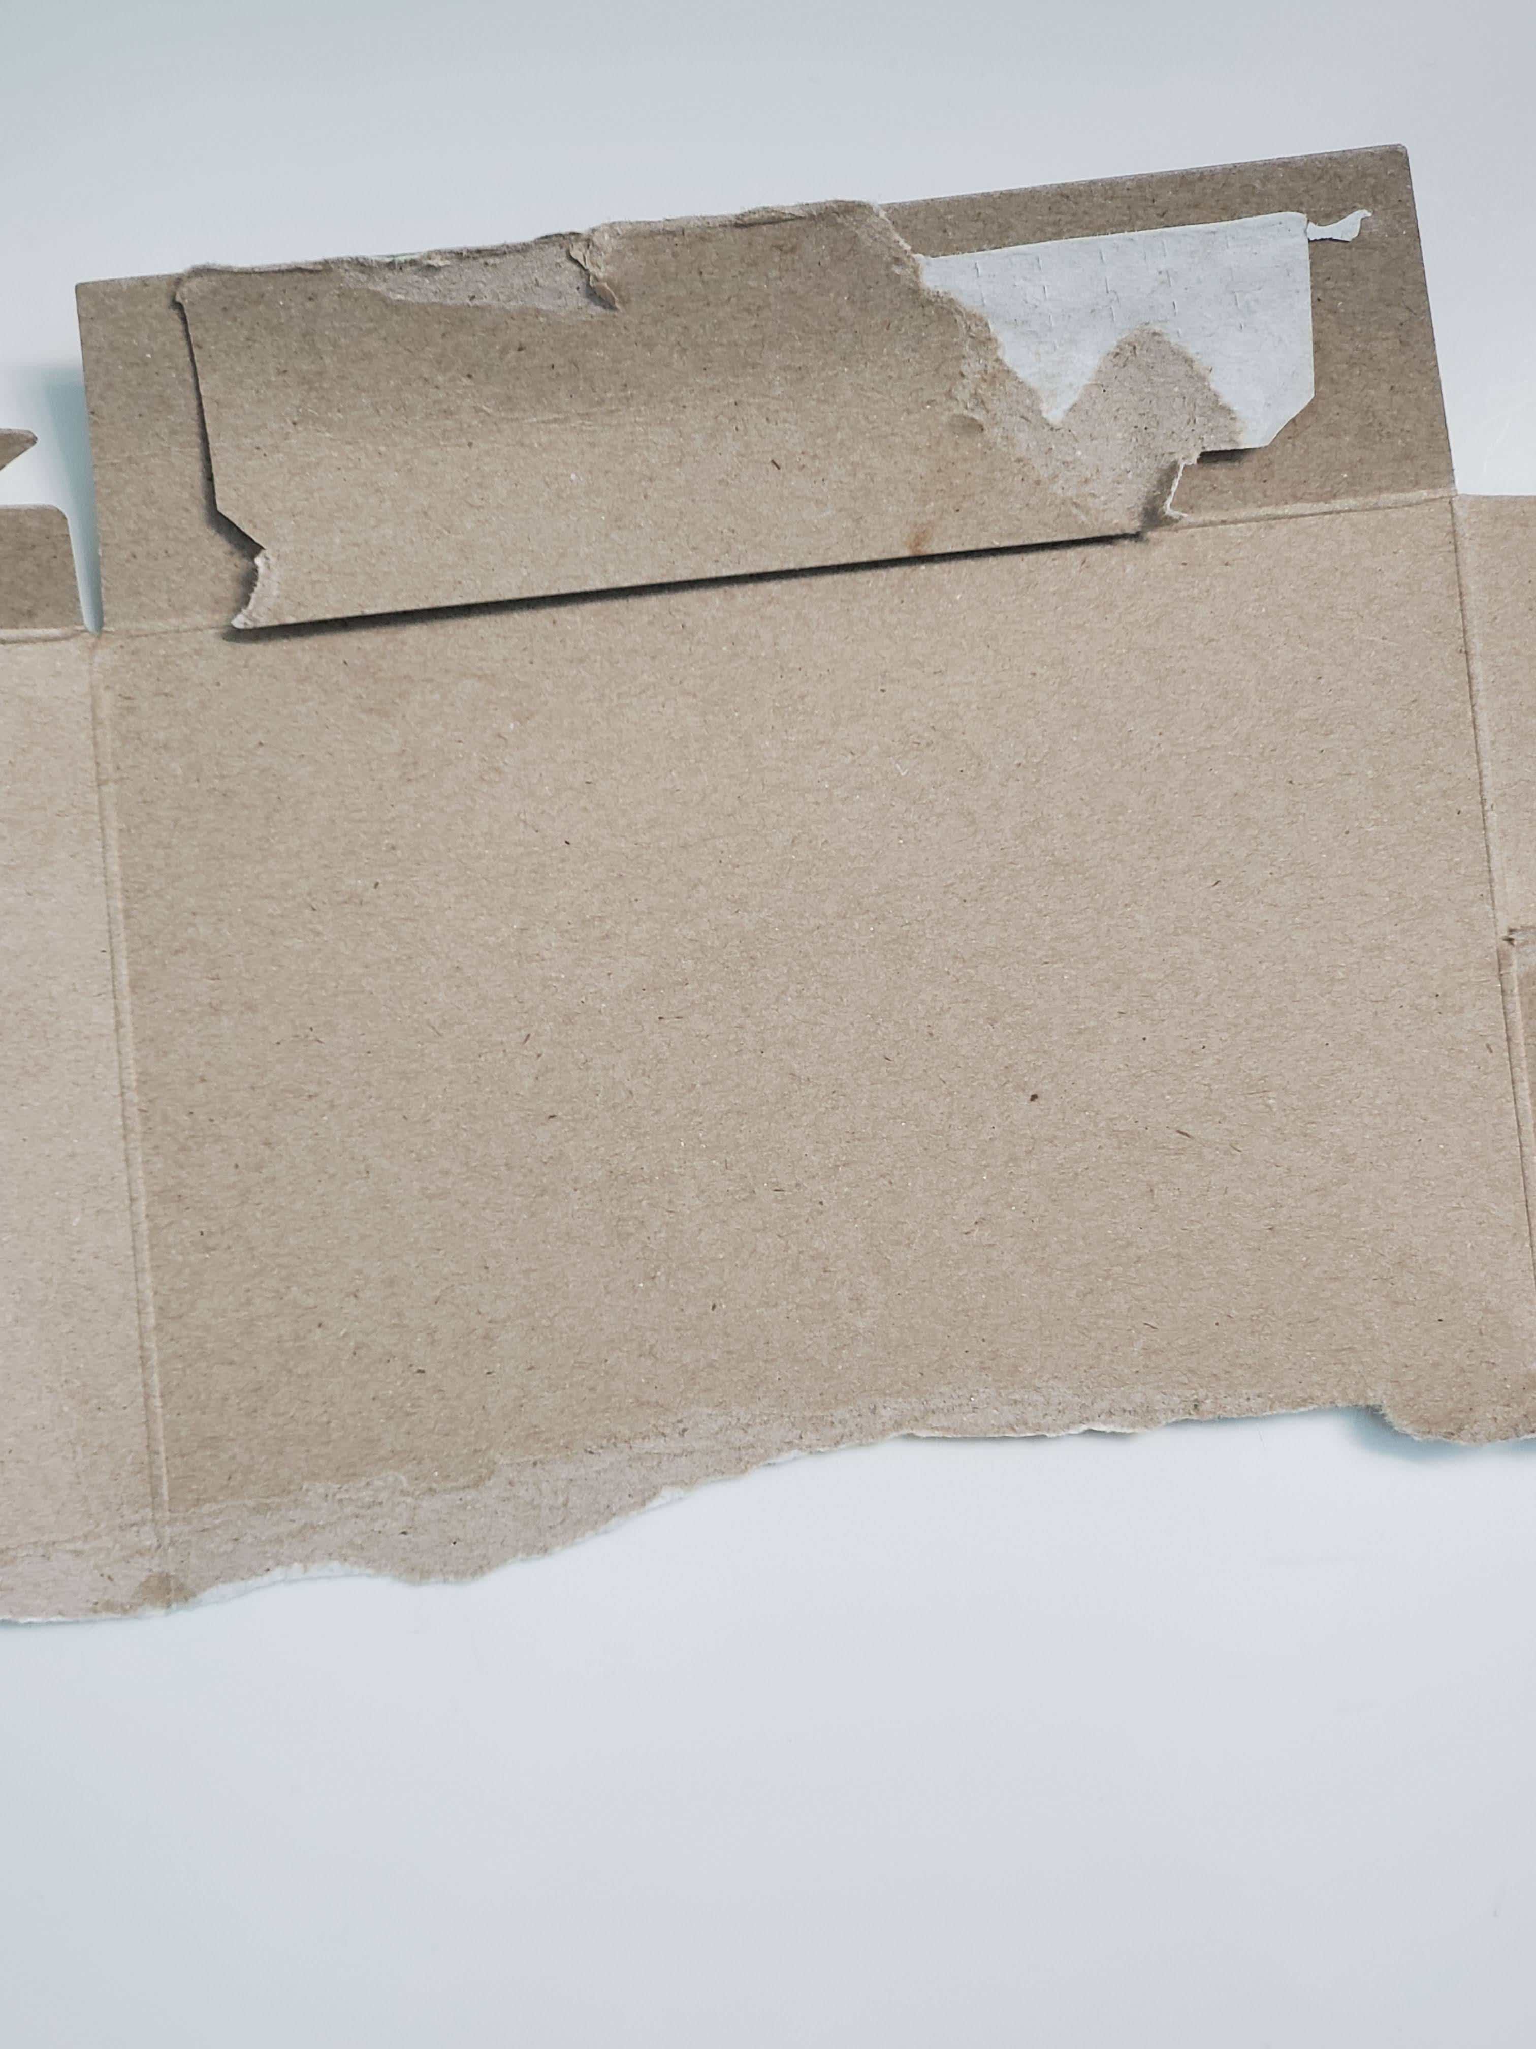
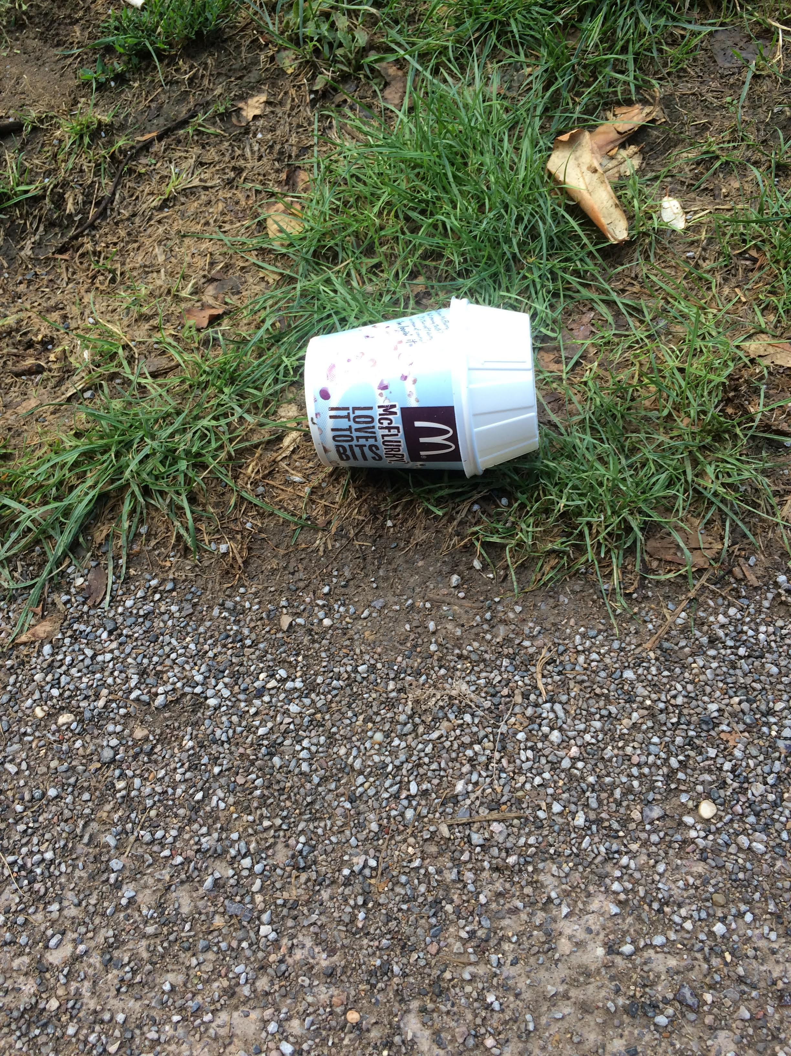
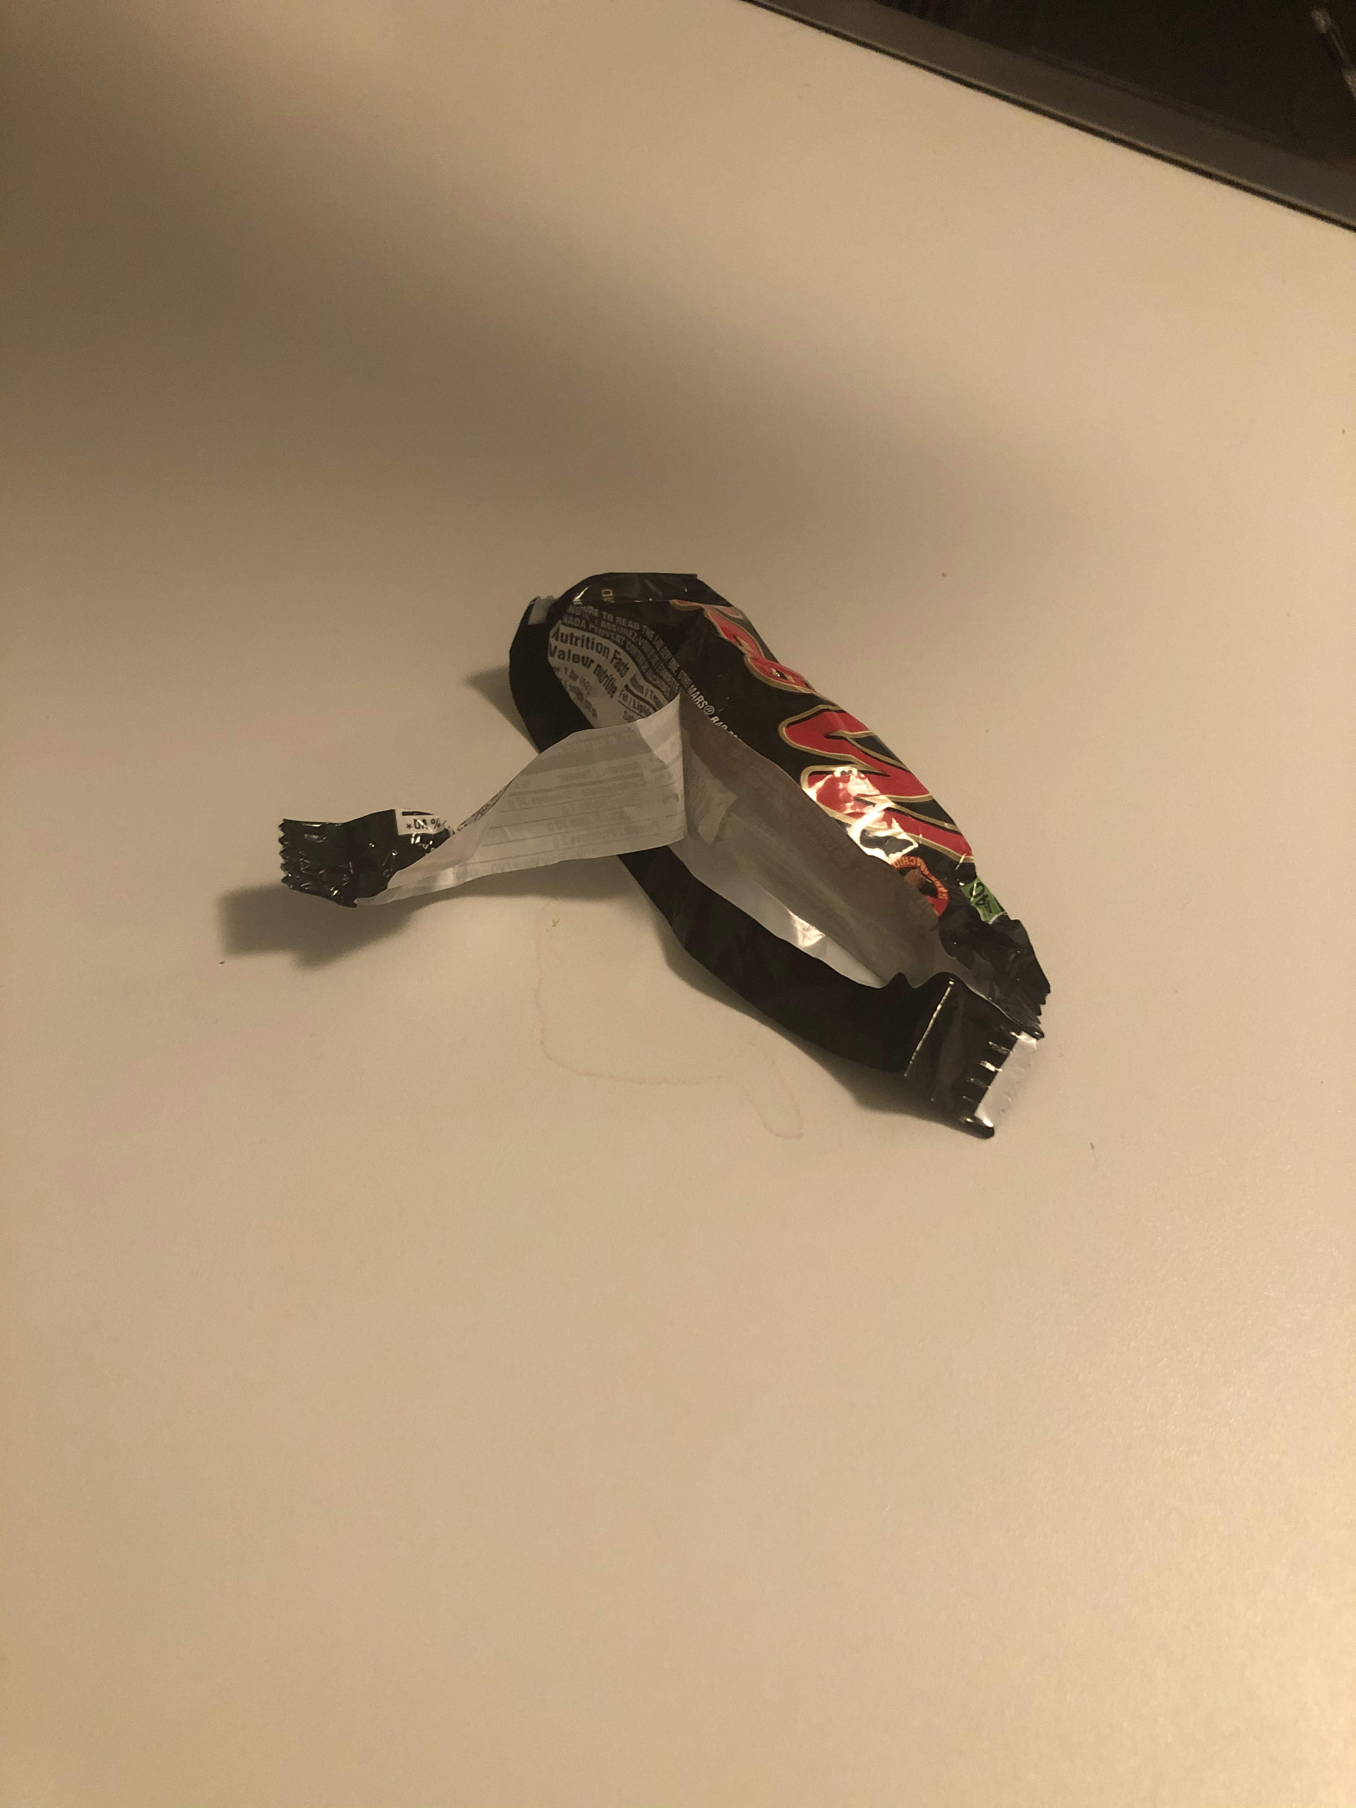
OUr photos & TACO dataset
Success cases ✅
Error cases ❌
Class: plastic predicted: cardboard
Class: cardboard predicted: cardboard
Accuracy lost when tested on images with complex background
Class: trash predicted: metal
Class: trash predicted: trash

Slide 9
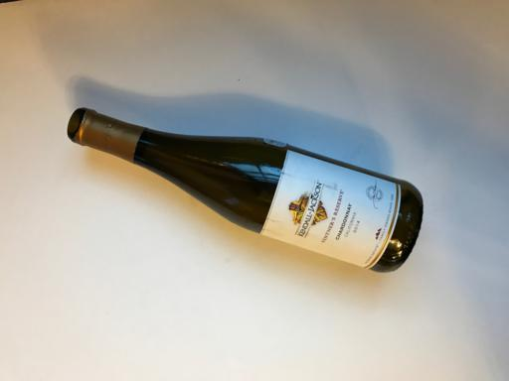
Discussion
Sample data was gathered in controlled environment
Solid colour background
Same camera used
Single object per image
Sample size was relatively small
≈ 500 per class
Imbalance size for one class
Trash class difficult to interpret (even by humans!)

Slide 10
Future work
Integrate Object-Detection networks (YOLO) for real time object labeling to have more general.
Using datasets with more sophisticated data labeling and more data variations (instead of controlled data aggregation)
Using Contrastive Learning is proved to be useful for classification.

Slide 11
THANKS

